Slide 1
CIS 4526 Foundations of Machine Learning
Chapter 17
Deep Learning with Sequential Data
Slides adapted from
WenPeng Yin 4526 Temple University Fall 22
MIT Introduction to Deep Learning Lecture 2 6S191_MIT_DeepLearning_L2.pdf (introtodeeplearning.com)
Fei-Fei Li (http://cs231n.stanford.edu/slides/2017/cs231n_2017_lecture10.pdf)
Yun-Nung Chen (https://www.csie.ntu.edu.tw/~miulab/s107-adl/doc/190409_GatingMechanism.pdf)

Slide 2
Outline
Deep Learning for Time-Series Data
Recurrent Neural Network (RNN)
Long Short-Term Memory (LSTM)
Gated Recurrent Unit (GRU)
Attention (next lecture)
(use MIT lecture Transformers starting from 43:10)

Slide 3
Deep Learning for Time Series, Sequence Data
Name something that will not be changed forever
Change is the only thing that will not be changed
Nothing will stay the same forever

Slide 4
Deep Learning for Time Series, Sequence Data
Target variable will change
Features will change
=> Time Series Data

Slide 5
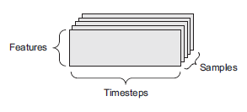
Deep Learning for Time Series, Sequence Data
Vector data – 2D tensors (samples, features)
Timeseries data or sequence data – 3D tensors of shape (samples, timesteps, features) (tensor of rank-3)
Examples:
Temperature over time
Stock Price over time
Growth of a teenage (height, weight, age) over time
Income over time with (age, income history, education)

Slide 6
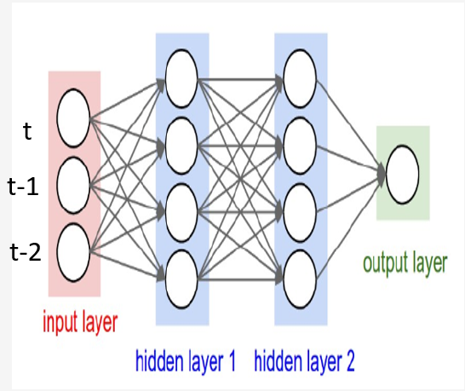
Naïve way of modelling Time Series data
Example: 1 year (250 days) of Apple stock price. Can we use last month (20 days) stock price to forecast the next day Apple stock price?
Sample consecutive 21 days of Apple stock price, then
flatten the 20 days of Apple stock price into a single
large vector and processed it as single sample.
Use the 21st day price as the target value.
Treat each value in previous timesteps as a separate features
Pro:
Easy to understand
Can reuse what we have learned before
Con:
Need to feed the whole sequence into the network
Or one can pick a cutoff, say, anything older than 20 steps before does not matter
No concept of recent data may be more relevant than old data

Slide 7
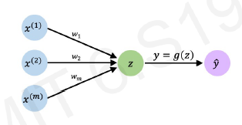
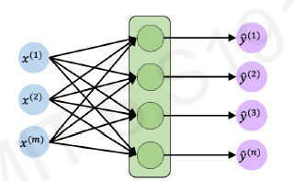
The Standard Neural Network Revisited
Single Perceptron
No hidden layer, one single output
With hidden layer and
Multiple output

Slide 8
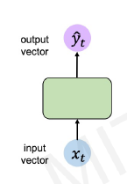
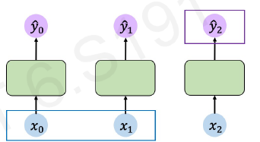
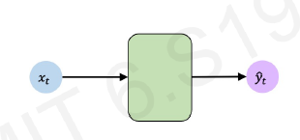


Feed-Forward Networks Abstracted out
input vector
output vector
$\hat{y_{t}}$ $=f(x_{t})$
$\hat{y_{t}}$ $=f(x_{t})$
Same diagram, but rotated 90 degree
So that we can play out the time component horizontally

Slide 9
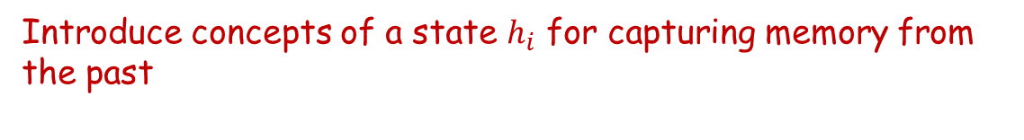




Feed-Forward Networks Abstracted out
$$h_{0}$$
$$h_{1}$$
$$y_{t}=f(x_{t})$$
Introduce concepts of a state $h_{i}$ for capturing memory from the past
$$y_{t}=f(x_{t}, h_{t−1})$$
output
input
past memory

Slide 10
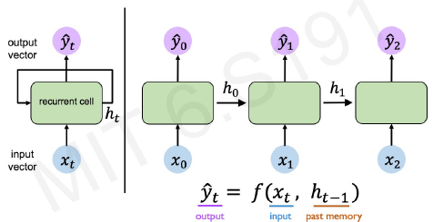
Neurons with Recurrence

Slide 11
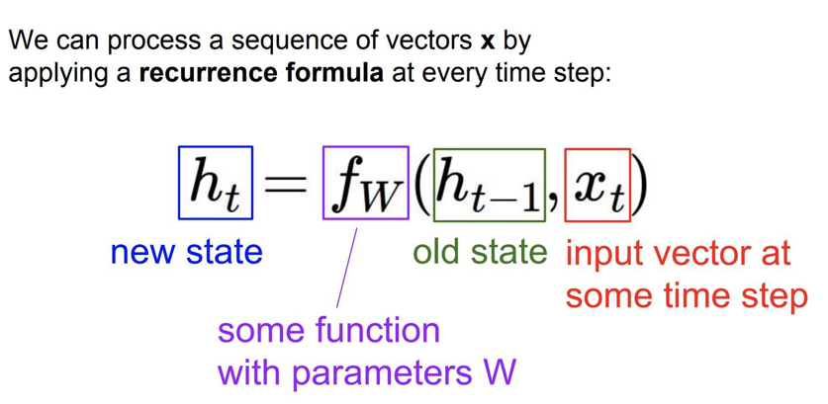
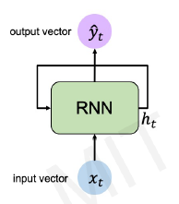
Recurrent Neural Networks (RNNs)

Slide 12
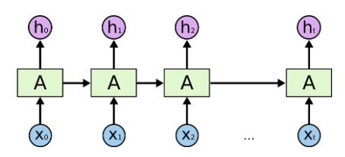
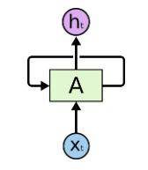

Recurrent Neural Networks (RNNs)
Unfold
Note: it requires 3 weights matrix for each RNN unit
Understanding LSTM Networks -- colah's blog

Slide 13
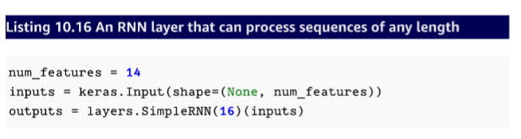
RNNs in Keras
Recall input shape is
(batchsize, timesteps, num_features)
However, we specify the shape of the input as (None, num_features)
The None is used to tell Keras to process whatever that are in the datasets

Slide 14
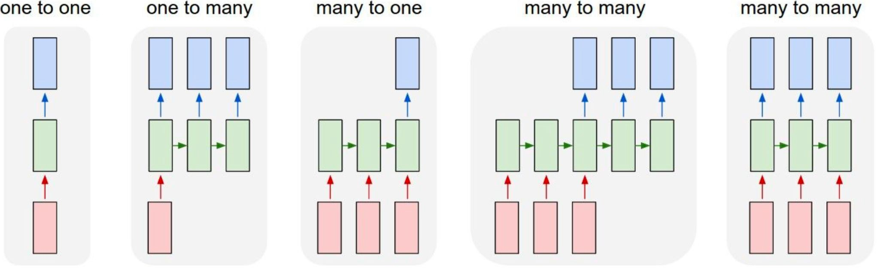
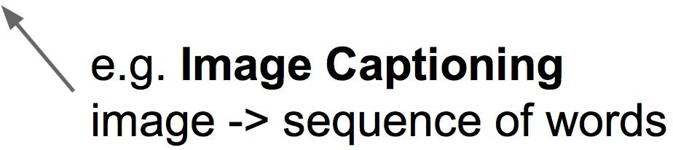
Recurrent Neural Networks: Application examples

Slide 15
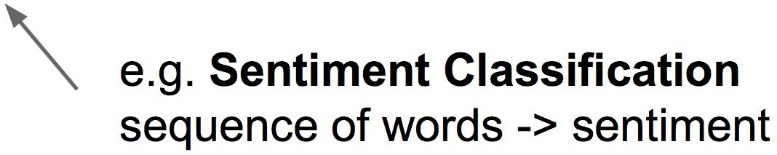
Recurrent Neural Networks: Process Sequences

Slide 16
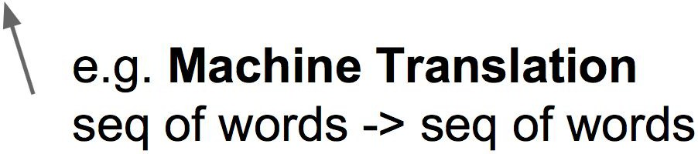
Recurrent Neural Networks: Process Sequences

Slide 17
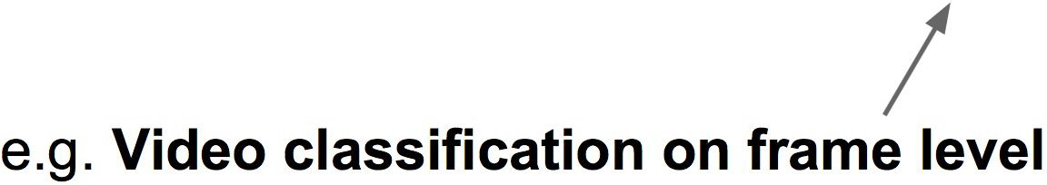
Recurrent Neural Networks: Process Sequences

Slide 18
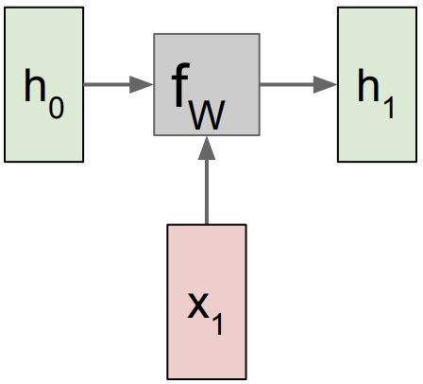
RNN: Computational Graph

Slide 19
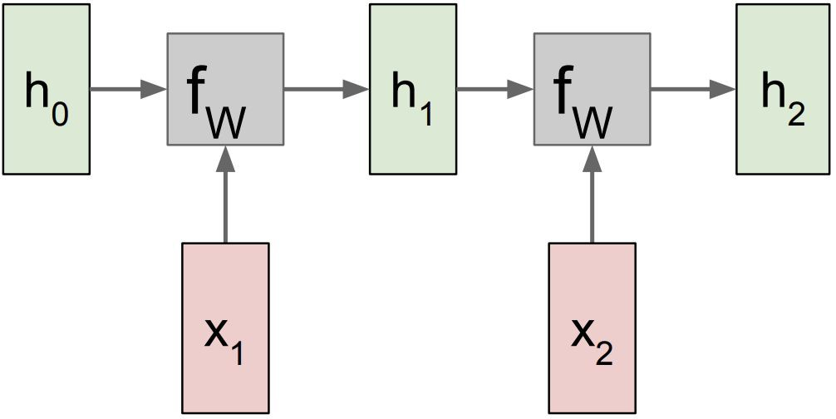
RNN: Computational Graph

Slide 20
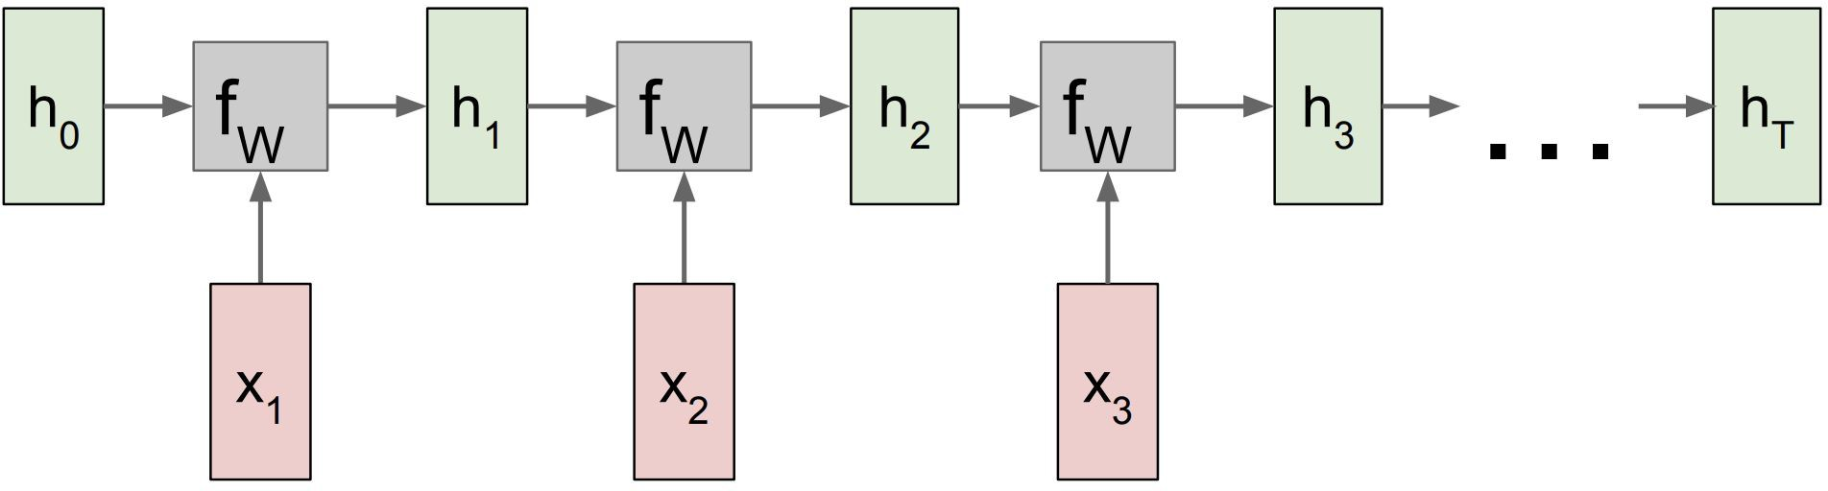
RNN: Computational Graph

Slide 21
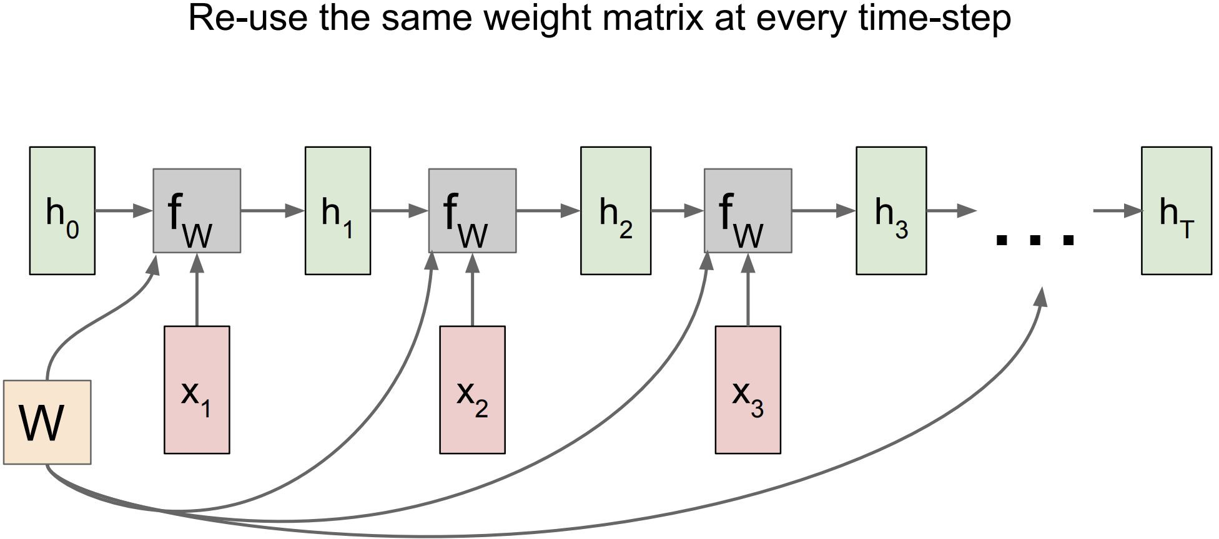
RNN: Computational Graph

Slide 22
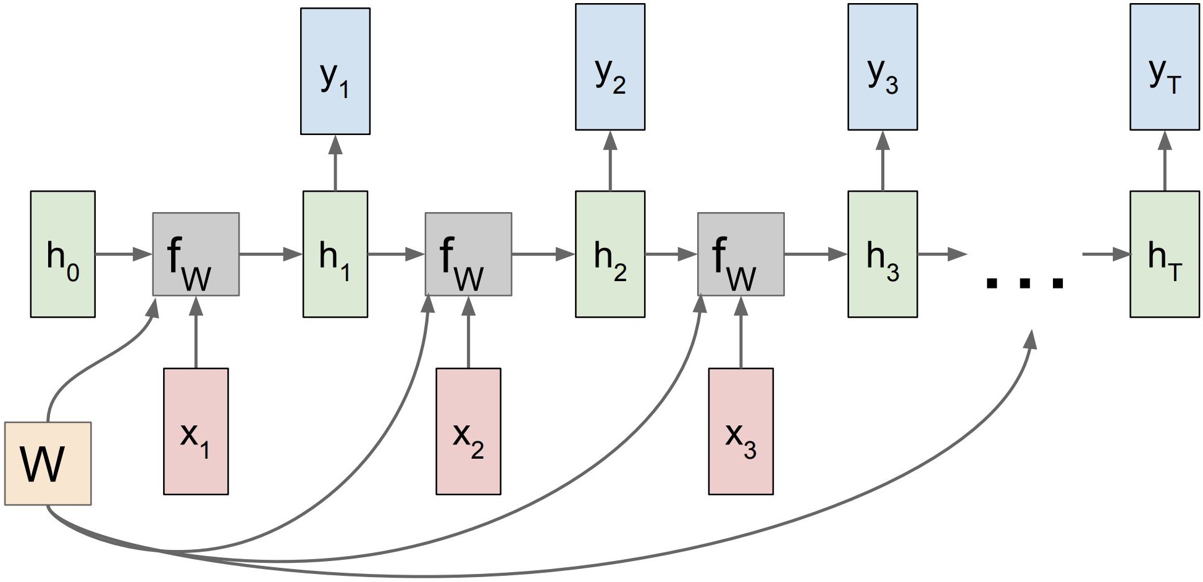
RNN: Computational Graph: Many to Many

Slide 23
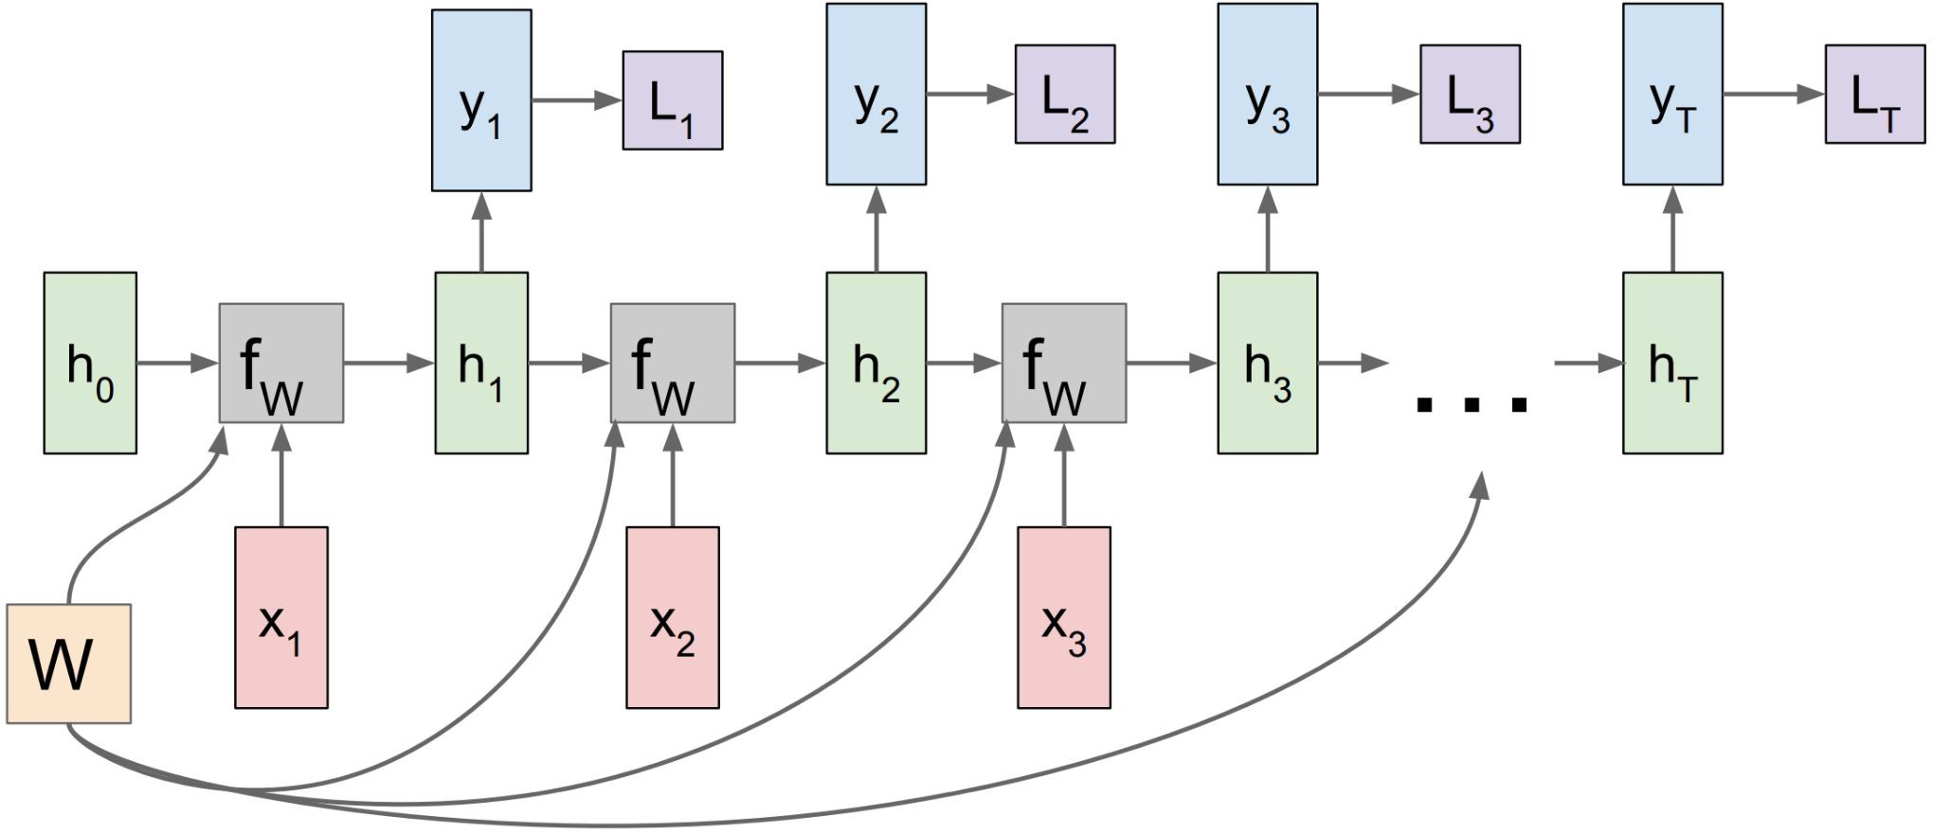
RNN: Computational Graph: Many to Many

Slide 24
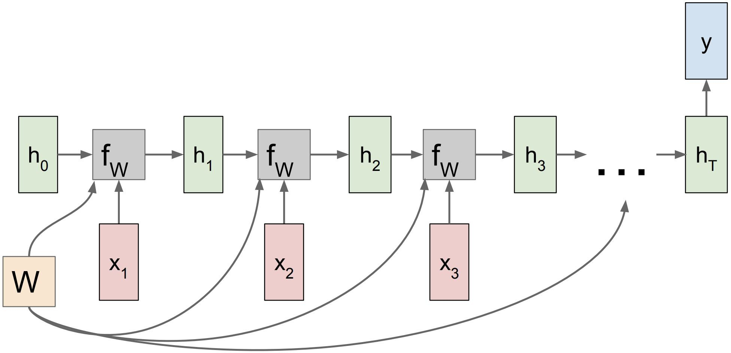
RNN: Computational Graph: Many to One

Slide 25
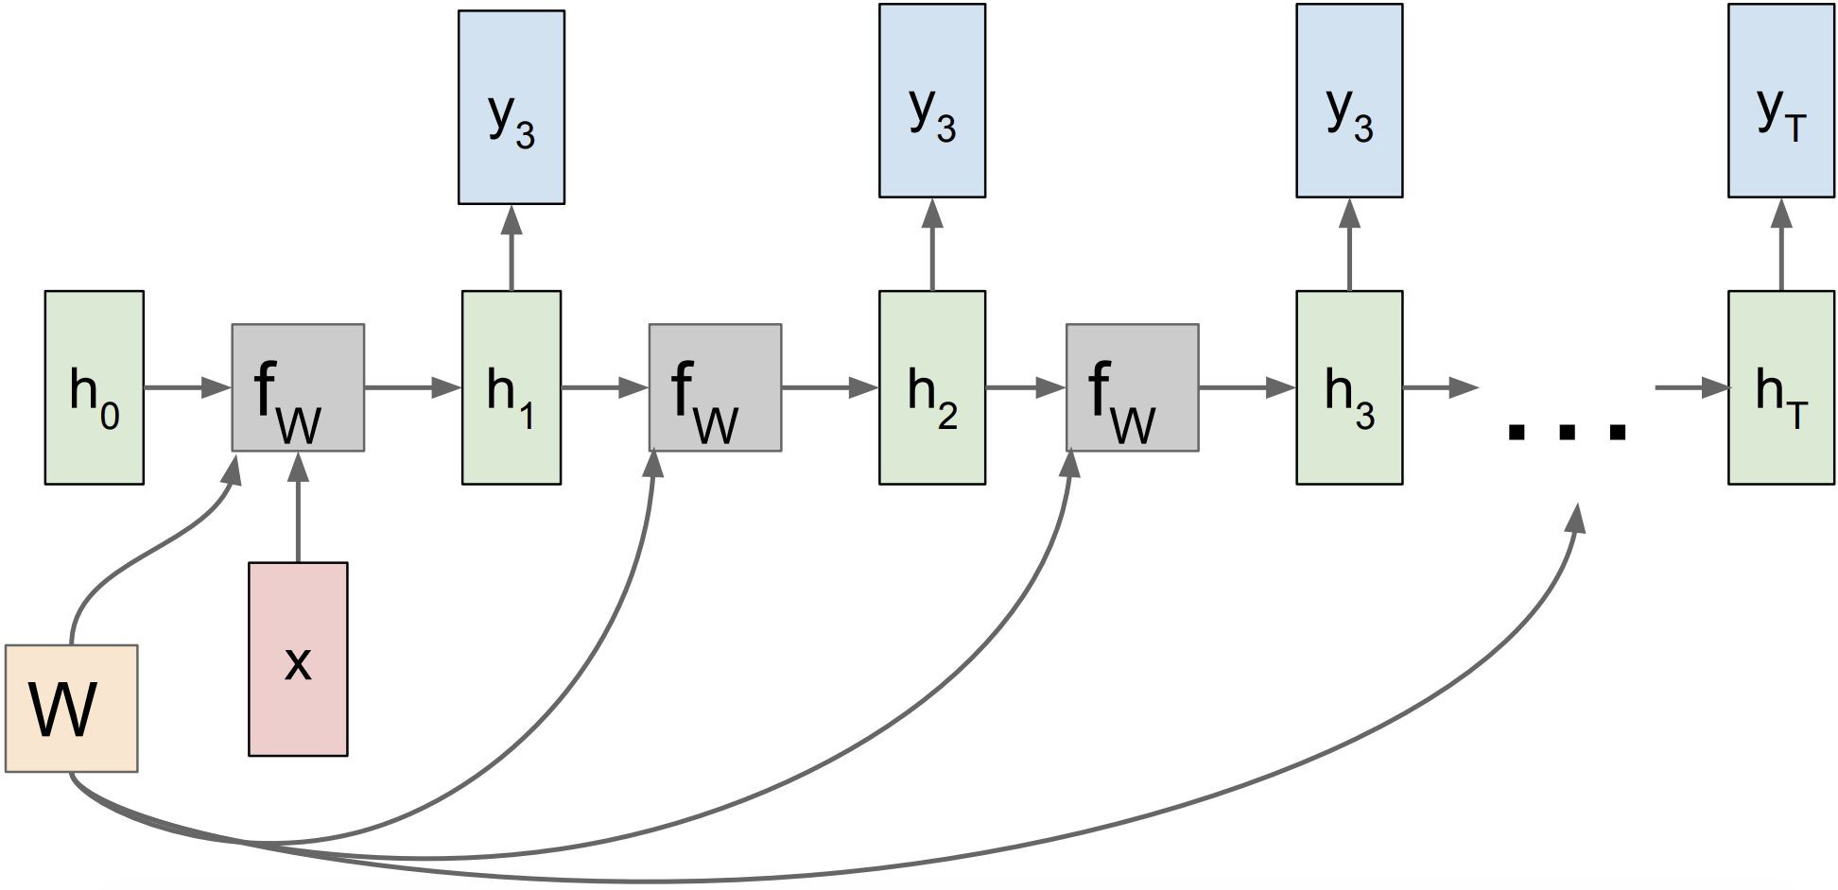

RNN: Computational Graph: One to Many

Slide 26
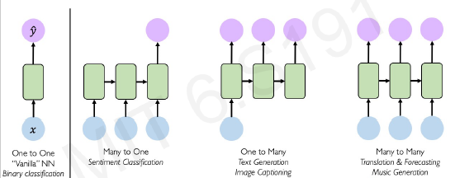
RNNs for Sequence Modeling

Slide 27
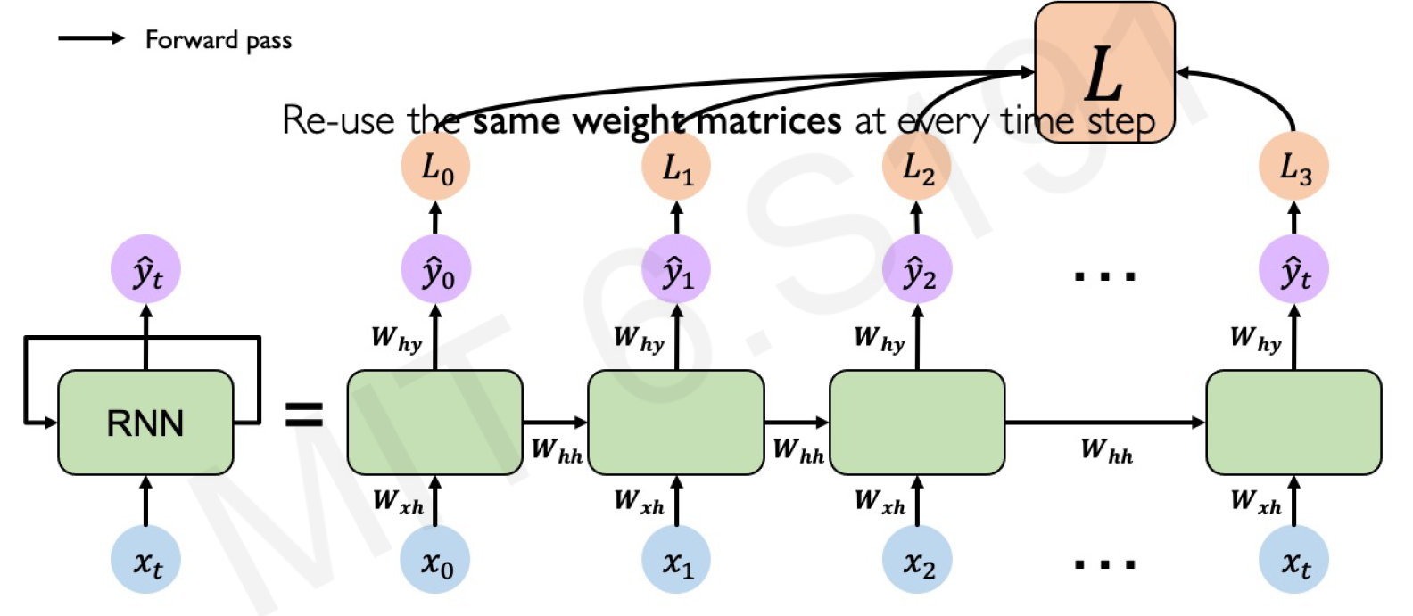
RNNs: Computational Graph Across Time

Slide 28
Problem with RNNs
When backpropagating error from the Loss function over time, it involves multiplication of the same weight matrix, W
If the gradient is small (less than 1), multiplication of small numbers becomes smaller and smaller, this gives rise to the vanishing gradient problem.
If the gradient is big (larger than 1), multiplication of big numbers will give rise of the exploding gradient problem
As the gap between the location between cause-and-effect increase, the dependence of the present from the distant past becomes harder and harder to be estimated reliably in the optimization algorithm

Slide 29
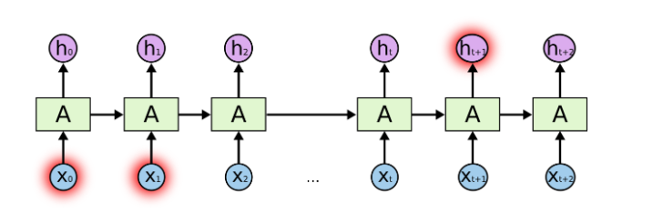
Problem with RNNs
RNNs theoretically contain and retain long-term information, however, in practice it is very difficult to train the network because of the vanishing gradient problem which simply states that the sensitivity of the of the weights (model parameters) cannot be reliably calculated when the gradient is too small.

Slide 30
Problem with RNN
LSTM (Long-Short Term Memory Model) and GRU (Gated Recurrent Units) are more popular in practice.
The basic ideas is to NOT remember everything, use a so-called “forget gate” (decide which features are not important) and “update gate” (incorporate the new information and feed forward) to moderate the right amount of information stored in the networks so that it can still be trained properly

Slide 31
Solution to RNN
Long Short-Term Memory Model
Concepts of a gate (computed or derived state information)
Use a “forget gate” to selectively drop unimportant information
Use an “input gate” to capture new information coming in at time t
Use a “cell state” to maintain the current state of information

Slide 32
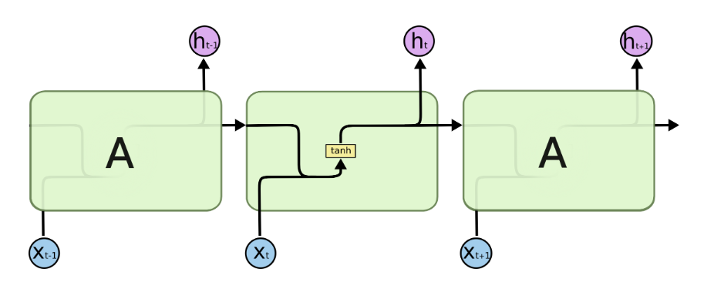
Standard RNN
The repeating module in a standard RNN contains a single layer

Slide 33
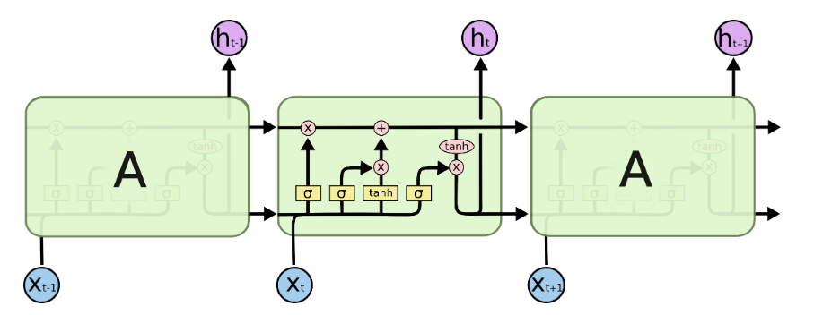
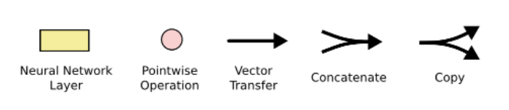
LSTM
C(t)
H(t)
The repeating module in an LSTM contains four interacting layers
C(t) = Cell State
H(t) = hidden State

Slide 34
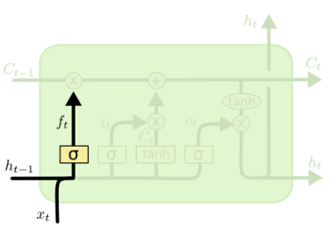
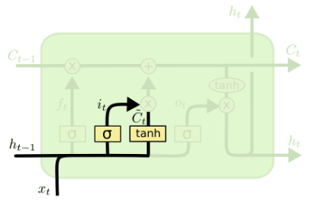
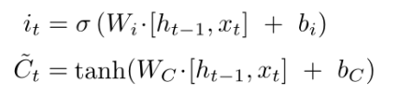

LSTM
Forget gate to decide what information to forget
Input gate
Combine input with hidden state

Slide 35
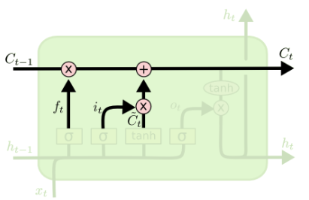
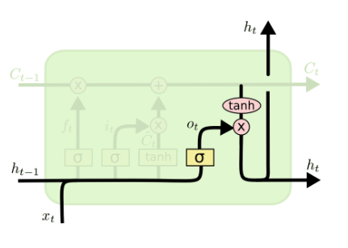

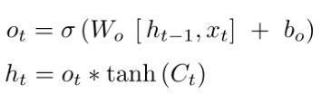
LTSM
Update Cell state by forget gate and input gate
Activate output from the hidden state
Update hidden state from the output and Cell state

Slide 36
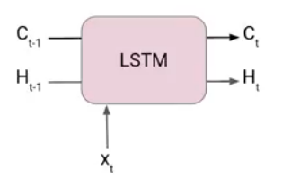
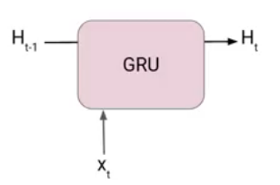
GRU (Gated Recurrent Network) (simplified LSTM)
LSTM has 3 gates: input, forget and output
GRU has only 2 gates: reset and update

Slide 37
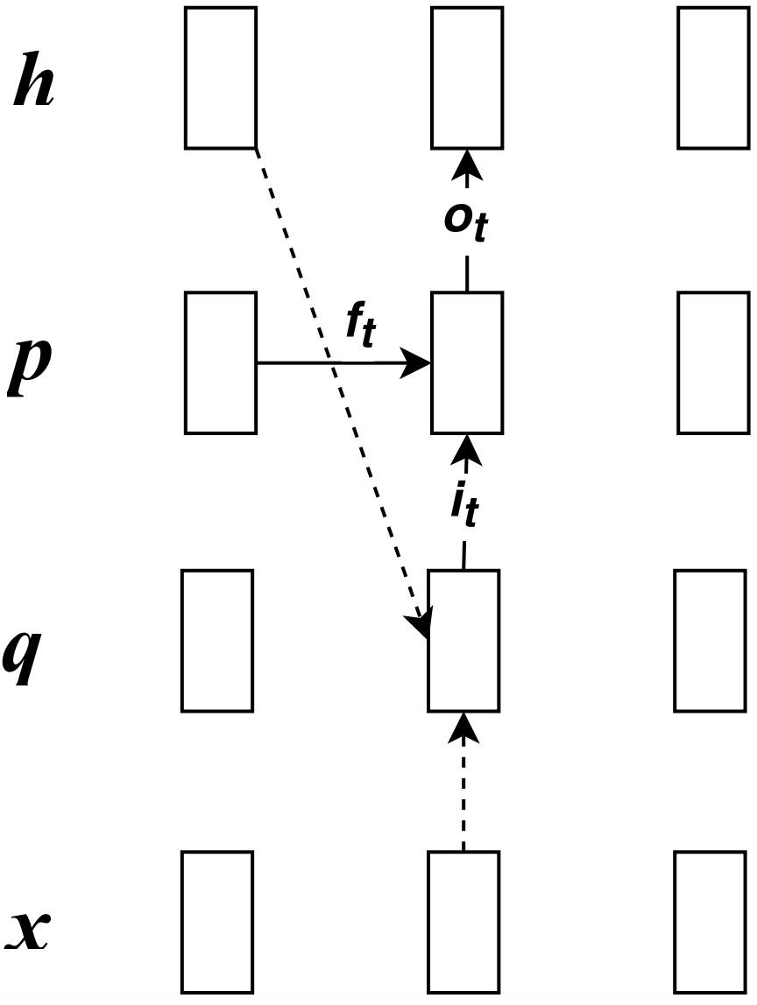
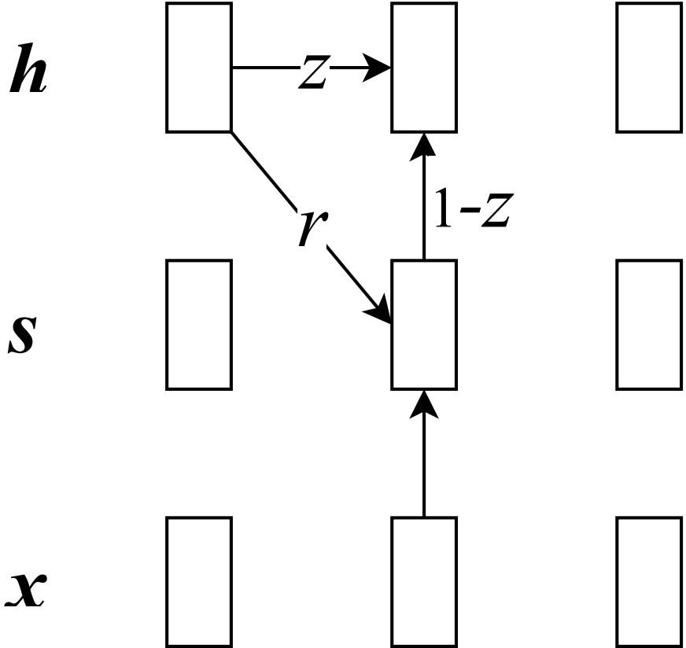
GRU
LSTM
GRU
48

Slide 38
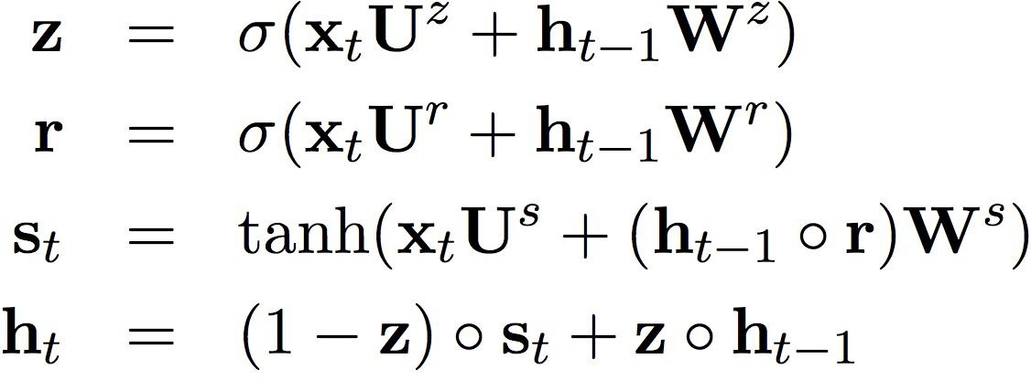
Two gates
GRU

Slide 39
GRU
combine the input with decayed history

Slide 40
GRU
combine the input with decayed history

Slide 41
GRU
incorporate history again

Slide 42
Online Resources
https://machinelearningmastery.com/how-to-develop-lstm-models-for-time-series-forecasting/
https://www.analyticsvidhya.com/blog/2021/03/introduction-to-long-short-term-memory-lstm/
https://www.analyticsvidhya.com/blog/2021/03/introduction-to-gated-recurrent-unit-gru/
https://www.analyticsvidhya.com/blog/2021/03/introduction-to-long-short-term-memory-lstm/
https://towardsdatascience.com/understanding-gru-networks-2ef37df6c9be
https://towardsdatascience.com/illustrated-guide-to-lstms-and-gru-s-a-step-by-step-explanation-44e9eb85bf21
https://analyticsindiamag.com/lstm-vs-gru-in-recurrent-neural-network-a-comparative-study/

